Slide 1
Emotional Understanding and Regulation
Featuring Emotion Talks / Kitbag and 5 Point Scale

Slide 2
About this resource
This pack has been put together to encourage the use of three resources – Emotion Talks / Kitbag and The Incredible 5 Point Scale in collaboration, rather than individually.
All three resources are extremely useful in helping children in a number of ways such as - to develop understanding of emotions, increase resilience and confidence and also develop emotional self regulation – to name just a few. All three resources have a sound theoretical basis.
Links to Curriculum for Excellence are on the next slide.
As the resources can be used with different ages this isn’t a bank of lessons – however it would be extremely useful if people could add lesson ideas that they’ve successfully tried and we can add them to the list.
The basic order of Things to do are in red and the Ideas are in black.

Slide 3
Curriculum for Excellence
Mental and Emotional Health and Wellbeing
I am aware of and able to express my feelings and am developing the ability to talk about them.
HWB 0-01a / HWB 1-01a / HWB 2-01a / HWB 3-01a / HWB 4-01a
I know that we all experience a variety of thoughts and emotions that affect how we feel and behave and I am learning ways of managing them.
HWB 0-02a / HWB 1-02a / HWB 2-02a / HWB 3-02a / HWB 4-02a
I understand that there are people I can talk to and that there are a number of ways in which I can gain access to practical and emotional support to help me and others in a range of circumstances.
HWB 0-03a / HWB 1-03a / HWB 2-03a / HWB 3-03a / HWB 4-03a

Slide 4
Curriculum for Excellence
Mental and Emotional Health and Wellbeing
I understand that my feelings and reactions can change depending upon what is happening within and around me. This helps me to understand my own behaviour and the way others behave.
HWB 0-04a / HWB 1-04a / HWB 2-04a / HWB 3-04a / HWB 4-04a
I know that friendship, caring, sharing, fairness, equality and love are important in building positive relationships. As I develop and value relationships, I care and show respect for myself and others.
HWB 0-05a / HWB 1-05a / HWB 2-05a / HWB 3-05a / HWB 4-05a
I understand the importance of mental wellbeing and that this can be fostered and strengthened through personal coping skills and positive relationships. I know that it is not always possible to enjoy good mental health and that if this happens there is support available.
HWB 0-06a / HWB 1-06a / HWB 2-06a / HWB 3-06a / HWB 4-06a

Slide 5
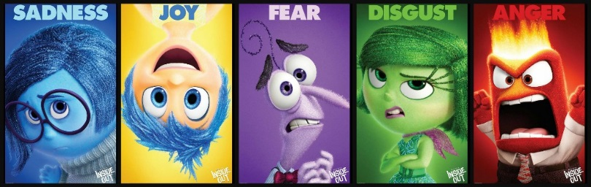
Introduction
1. Watch all or part of ‘Inside Out’ video (Whatever is appropriate)
After watching all or parts of Inside Out complete appropriate follow up activities.
2. Introducing Kit Bag
Use the Kitbag animals to explore the words on the cards (Resource 10)
Follow up ideas –
Build up understandings of basic emotions over a series of lessons. Ensure pupil’s understandings of basic emotions before introducing others. (like / don’t like, happy / sad, angry, scared)
Inside Out - Complete the sheets (slides 5-15) describing the characters in Inside Out – the children may choose to draw or write, in groups or individually – whatever is age appropriate. The examples are only there as a very rough guide.
Display the animal cards and allow the children to add post-its (example below)

Slide 6
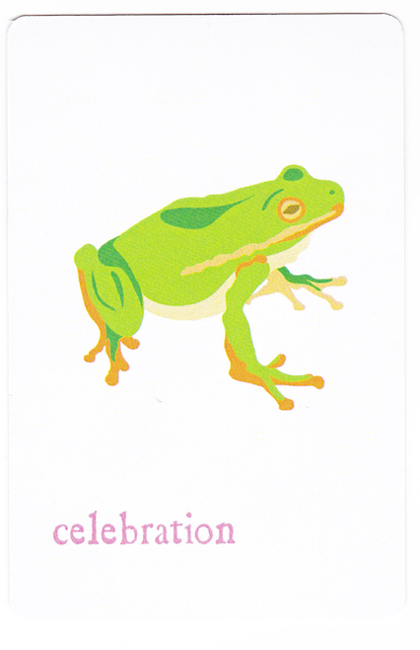
I’m giving Hannah the celebrating card because she did well in the spelling test
John was celebrating because it was his birthday
I’m celebrating today because I won a medal at gymnastics (Fiona)
I think Joseph should be celebrating because he did well in the school play
I finished my work (Cara)

Slide 7
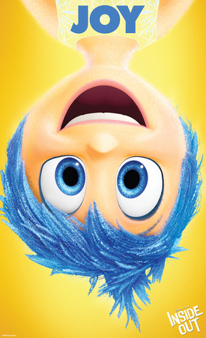
Joy
Who is Joy and what does she do for Riley?

Slide 8
Joy - examples
Joy’s goal has always been to make sure Riley stays happy.
She is lighthearted, optimistic and determined to find the fun in every situation.
Joy sees challenges in Riley’s life as opportunities, and the less happy moments as hiccups on the way back to something great.
As long as Riley is happy, so is Joy.

Slide 9
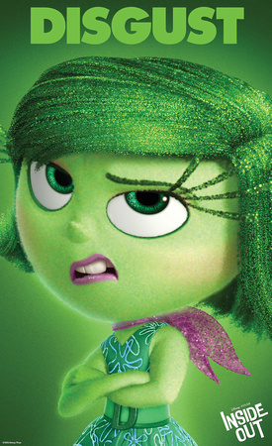
Disgust
Who is Disgust and what does she do for Riley?

Slide 10
Disgust - examples
Disgust is highly opinionated, extremely honest and prevents Riley from getting poisoned — both physically and socially.
She keeps a careful eye on the people, places and things that Riley comes into contact with — whether that’s broccoli or last year’s fashion trend.
Disgust always has the best of intentions and refuses to lower her standards.

Slide 11
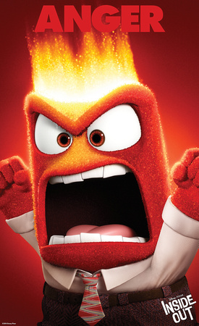
Anger
Who is Anger and what does he do for Riley?

Slide 12
Anger - examples
Anger feels very passionately about making sure things are fair for Riley.
He has a fiery spirit and tends to explode (literally) when things don’t go as planned.
He is quick to overreact and has little patience for life’s imperfections.

Slide 13
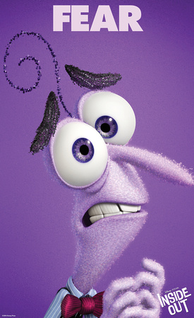
Fear
Who is Fear and what does he do for Riley?

Slide 14
Fear - examples
Fear’s main job is to protect Riley and keep her safe.
He is constantly on the lookout for potential disasters, and spends time evaluating the possible dangers, pitfalls and risk involved in Riley’s everyday activities.

Slide 15

Sadness
Who is Sadness and what does she do for Riley?

Slide 16
Sadness - examples
None of the other Emotions really understand what Sadness’s role is.
Sadness would love to be more optimistic and helpful in keeping Riley happy, but she finds it so hard to be positive.
Sometimes it seems like the best thing to do is just lie on the floor and have a good cry.

Slide 17
Draw a time when you felt each emotion

Slide 18
Introducing Kitbag
Introduce Kitbag and all the different components
Explain that we’re going to play lots of games using the different parts of the kit – they may want to make up games / activities of their own.
Explain that sometimes small groups will do more other work using Kitbag / sometimes we’ll use parts of the Kitbag only.
Ongoing ideas -
On a regular basis use the colour chart to chat in small groups using Talking Stick and colour charts
Play games with the animal cards – allow children to make up their own
Children make up their own slogan for Kitbag (other great names we’ve seen include Kindness Bag / Relax and Chillax @Kitbag)

Slide 19
Emotion Talks - Nice Feelings
(Feel free to change the pictures to suit interest / age etc. )
Look at Slide 1 - Footballer (Resource 1)
Describe a time when you had a similar emotion – bring in a photo perhaps
Choose one of the Kitbag animal cards which you could give to the footballer
Look at Slide 2 - Little Girl (Resource 2)
Choose one of the Kitbag animal cards which you could give to the little girl
Can you think of other words to describe how she is feeling?
Follow up ideas –
Choose one of the other pictures (Picture Bank) and write about it using. Feel free to use your own choice of pictures / stimuli here. (Resource 8)

Slide 20
Trigger - What happened?
Resource 8
How did it make you feel in your body?
How strong is the feeling?
Which words would you use to describe the feeling?
What did you do to show it?
How long did the feeling last?

Slide 21
Likes – things which make you happy
Complete ‘Likes’ worksheet – discuss with a partner (Resource 3)
Follow up ideas –
Make up a collage of ‘Things I Like’ – can be on going.
Include pictures / magazine cut outs / sensory objects / photographs etc.

Slide 22
Emotion Talks – Not nice feelings
Look at Slide 4 - Driver (Resource 4)
Describe a time when you had a similar emotion
Choose one of the Kitbag animal cards which you could give to the driver.
Look at Slide 2 - Ronaldo (Resource 5)
Discuss. Can you think of other words to describe how he is feeling?
Choose one of the Kitbag animal cards which you could give to Ronaldo.
Follow up ideas -
Choose one of the other picture and write about it using (Resource 8)

Slide 23
Trigger - What happened?
Resource 8
How did it make you feel in your body?
How strong is the feeling?
Which words would you use to describe the feeling?
What did you do to show it?
How long did the feeling last?

Slide 24
Dislikes – Things which make you unhappy
Complete ‘Dislikes’ worksheet – discuss with a partner (Resource 6)
Follow up ideas -
This could lead on to a discussion around how some people’s favourite things are other people’s ‘not’ favourite things
The Emotion Talks Framework could be used as a comparison here.

Slide 25
Emotion Talks Framework - Triggers
Talk about the Emotion Talks framework (Resource 7)
Explain and check understanding of trigger.
Ideas
Think of other words which mean the same as Trigger.
Use a variety of triggers to explore the Emotion Talks framework through drama

Slide 26
Emotion Talks Framework – Emotional words
Talk about the Emotion Talks framework (Resource 7)
Explain and check understanding of emotional words
Ideas
Play matching pairs with the emotional words this could be simply matching cards that are exactly the same or similar ( happy and delighted / calm and relaxed etc.)
Make up other games using the emotional words e.g. acting them out and others guessing the emotion.

Slide 27
Emotion Talks Framework – Body sensations
Talk about the Emotion Talks framework (Resource 7)
Explain and check understanding of body feelings / sensations
Ideas
Choose one of the pink body sensation cards. Describe what it is (act it out maybe). Using the Talking Stick from Kitbag children could describe a time they felt that sensation and try to remember the trigger.
If it was a negative emotion they could think about what might have helped (blue cards) and an animal card from Kitbag they might have needed.

Slide 28
Emotion Talks Framework – How to show it
Talk about the Emotion Talks framework (Resource 7)
Explain and check understanding of emotional behaviours
Ideas
Drama activities linking behaviour to emotion

Slide 29
Emotion Talks Framework – Intensity scale
Talk about the Emotion Talks framework (Resource 7)
Explain and check understanding of intensity scale.
Ideas
Explore the idea of different intensities from 1 to 5 -
loudness of voice (warn other staff you’re going to do this though!!). Voice Scale (Resource 13) can be used here.

Slide 30
Emotion Talks Framework – How to feel better
Talk about the Emotion Talks framework (Resource 7)
Explain and check understanding of ‘how to feel better’
Ideas
Explore different strategies to help children feel better (the feeling better will be closely linked to their ‘Likes’)
Aspects of Kitbag could me mentioned again here – relaxation techniques etc.
Children exploring and identifying their own personal strategies to make things better (examples on next slide)

Slide 31
How to Feel Better

Slide 32
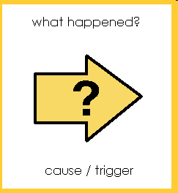
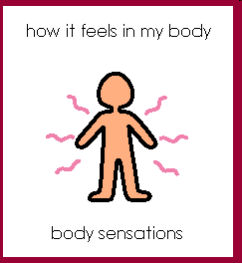
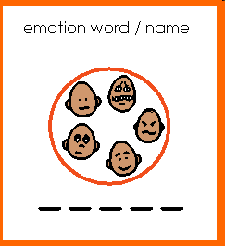
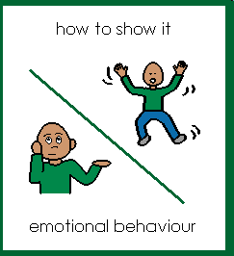
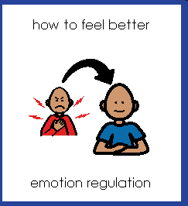
(Resource 7)

Slide 33
Using Emotion Talks and Kitbag
Choose some of the resources below to go through the different aspects of the chat boards OR choose picture of your own maybe tying in with a class novel / work topic etc. (Resource 19 might be useful here)
Consider which Kitbag Animal cards could be given to the different people / characters linking both resources.
Gradually build up all 6 aspects of the Emotion Talks frame work – this will depend on the age / stage of the children you’re working with.

Slide 34
Little Miss Muffet
Kitbag animal choice

Slide 35
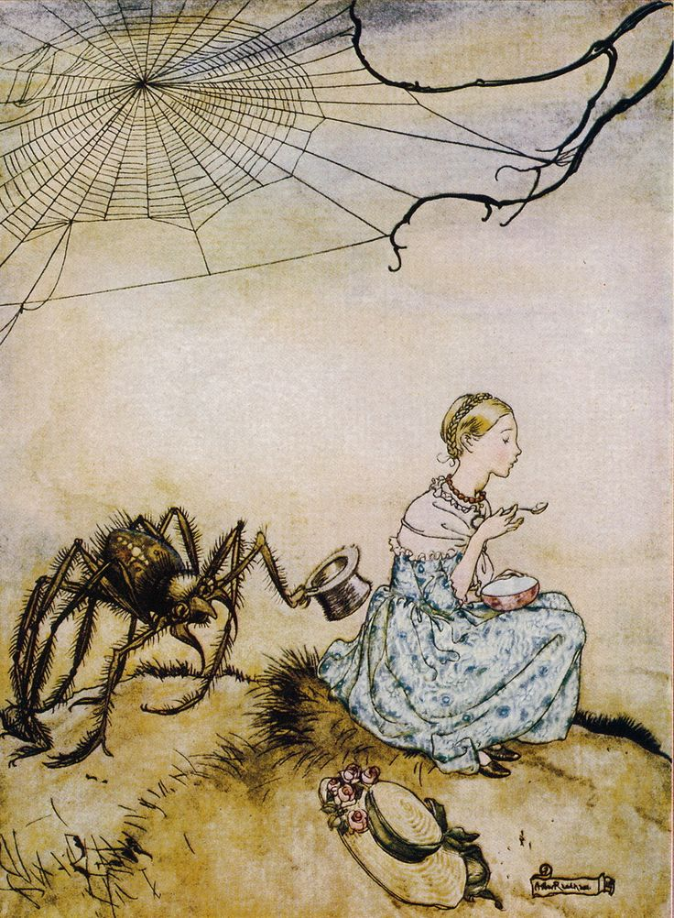

Slide 36
Simba
Kitbag animal choice

Slide 37
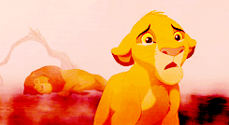

Slide 38
Charlie Bucket
Kitbag animal choice

Slide 39
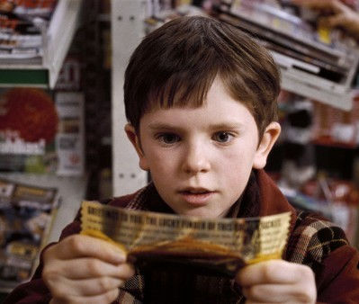

Slide 40
Little Red Riding Hood
Kitbag animal choice

Slide 41
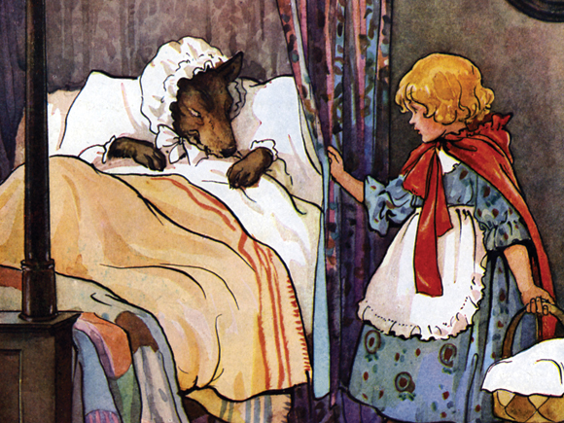

Slide 42
Old Man
Kitbag animal choice

Slide 43
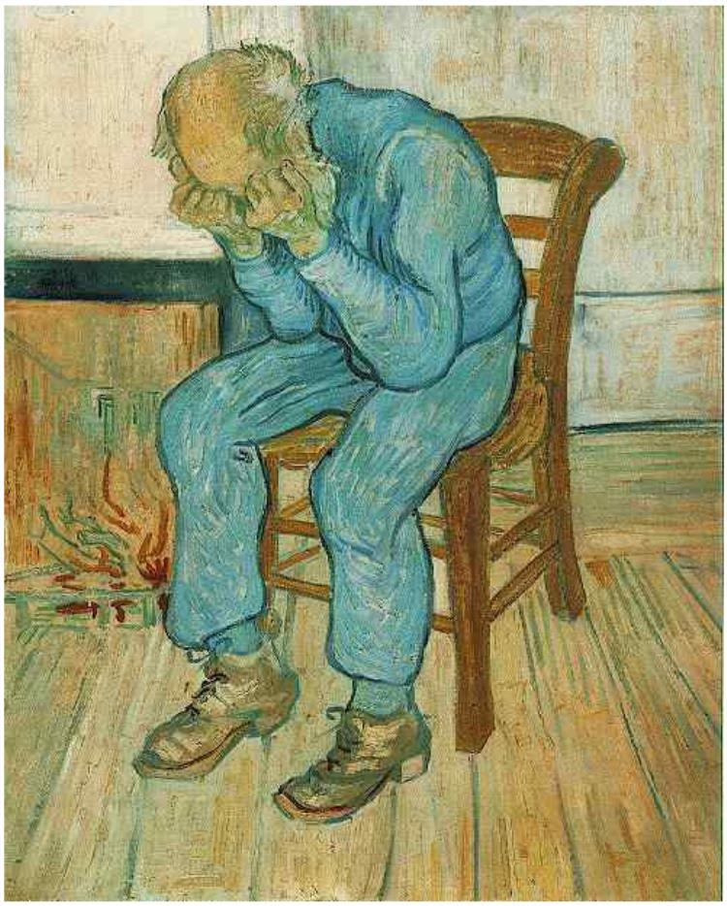

Slide 44
Little girl in bed
Kitbag animal choice

Slide 45
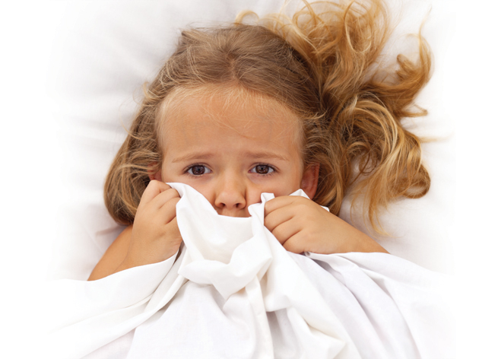

Slide 46
How Other People Think
Look at the ‘Recognising Emotions in Others’ power point. (Resource 18)
The Emotion Talks Framework can be used to help pupils understand that other people have different thoughts from their own.
Using 2 Emotion Talks board compare how both people will be feeling in the following pictures (choose most appropriate or create your own).
The slides could be printed out for groups to discuss.
The yellow Emotion Talks trigger should be highlighted again

Slide 47
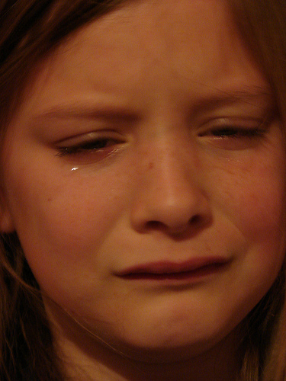
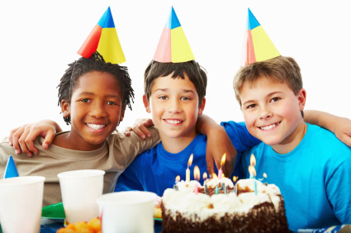
What happened - I went to Jenny’s birthday party. It was so much fun.
I blew out the candles on the cake before she could.
Me
Jenny

Slide 48
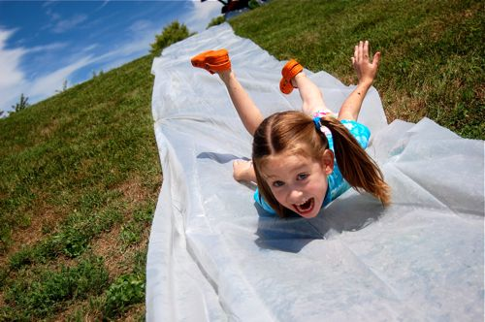
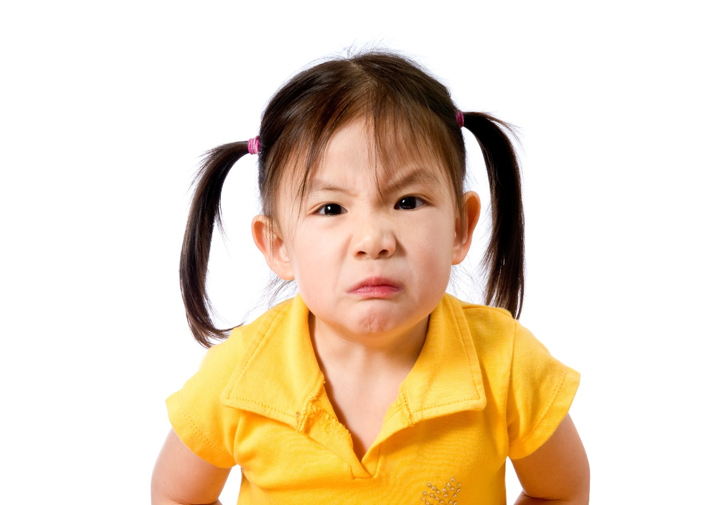
What happened - Lisa was taking ages on the slide. I pushed her out of the way so I could have a turn. The slide is so much fun!
Me
Lisa

Slide 49

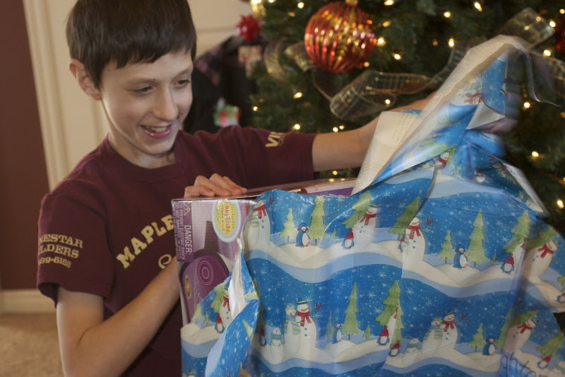
What happened - Mum put my Christmas presents under the tree. I was so excited I opened them straight away.
Mum
Me

Slide 50
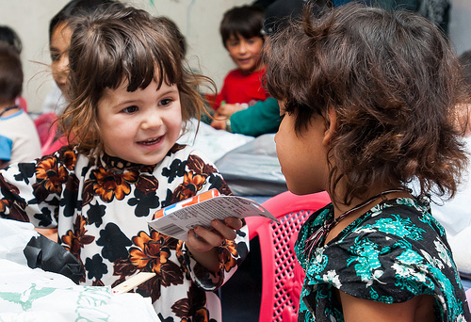
What happened - Carly shared her favourite Peppa Pig pictures with Nina because Nina liked them but didn’t have any
Carly
Nina

Slide 51
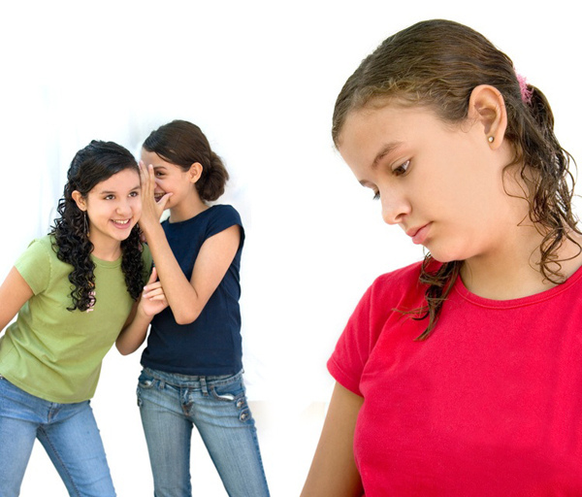
What happened - Ann and Sarah laughed at Molly when she got the wrong answer in class. She’s so stupid.
Ann and Sarah
        Molly

Slide 52
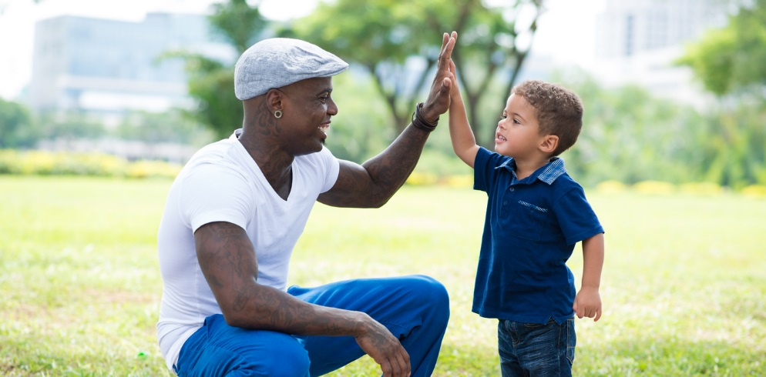
What happened - Fred said ‘Congratulations’ to Josh when he won the game. He played so well.
Fred
Josh

Slide 53

What happened - I said ‘Good Luck’ to Arran before his race. I hope he wins.
Arran’s thoughts

Slide 54
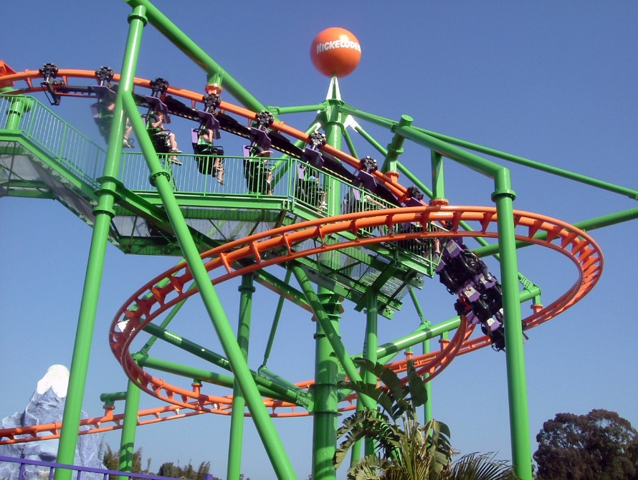
Act it out
What happened - You are standing in the queue with your friends waiting to go on a rollercoaster. One of your friends begin to feel really nervous.
How do they feel?
What words describe how they feel?
How do they show it?
How can you make them feel better?

Slide 55
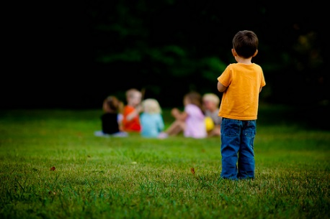
Act it out
What happened - Someone doesn’t let your friend join in the game that you are all playing.
How do they feel?
What words describe how they feel?
How do they show it?
How can you make them feel better?

Slide 56
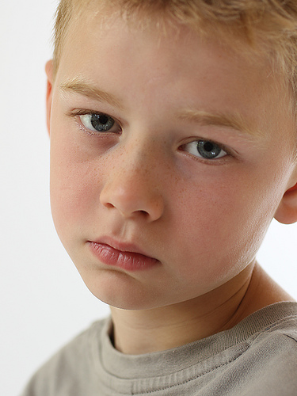
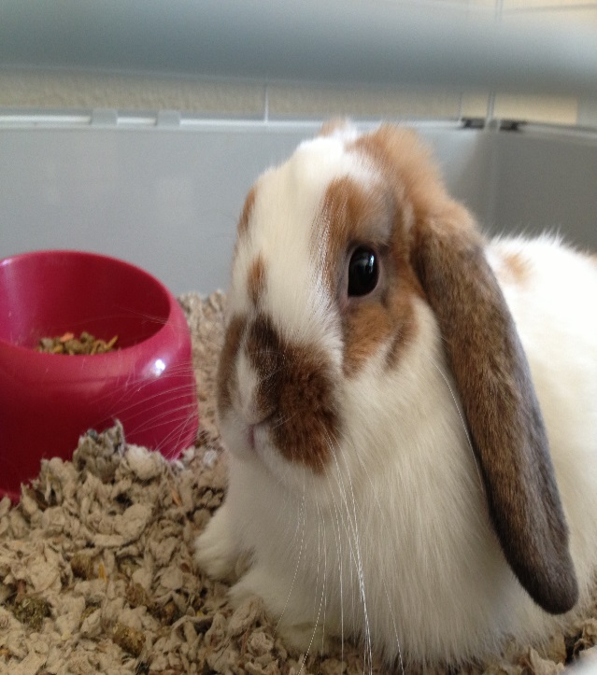
Act it out
What happened - One morning you go to visit your friend and discover that his pet died the evening before.
How do they feel?
What words describe how they feel?
How do they show it?
How can you make them feel better?

Slide 57
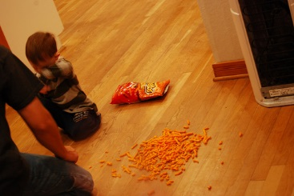
Act it out
What happened - Your little brother tried to open his favourite crisps but the packet burst and spilled on the floor.
How does he feel?
What words describe how he feel?
How does he show it?
How can you make him feel better?

Slide 58
Extra activity - Kind Hearts Story
Here’s a story that will help children understand why it’s important to be kind to their classmates. Cut a large heart out of red construction paper and hold it in your lap as you begin to tell the story below:
This is a story about a special friend named _____. He always came to school with a smile
on his face and a big heart full of love for his classmates. (Hold up the big heart.) ______
listened to his teacher, did his best work, and helped his friends. However, some of his
friends weren’t always so kind. Joe made fun of his shoes and broke a little of his
heart. (Tear off a piece of the heart and let it drop to the floor.) Ann said, “I’m saving
this seat and you can’t sit here” at story time and broke a little more of his heart. Sammy
wouldn’t share his crayons (tear off a little of the heart) and Sara called him a mean
name. What are some other things that might break his heart? (Let the children name
other things that cause hurt feelings as you let the pieces fall to the floor.) By the end of
the day his heart was all in pieces and it was so sad.
Who can tell me how to put his heart back together? What are some kind things you can do for your friends? As children name different acts of kindness pick the pieces of the heart off the floor. Glue the pieces together on a poster as a reminder to have a kind heart. Encourage children to write friends’ names on the poster when they are kind and helpful to them!

Slide 60
Introducing 5 Point Scale - Lesson 1
Talk about things you like and dislike (Use Resources 3 and 6 again – children may want to add to / change this)
Talk about things that make you happy and sad
Follow up ideas
Have a few emotion cards on the board or in groups. Ask children to talk about things they think of when looking at the emotion card.

Slide 61
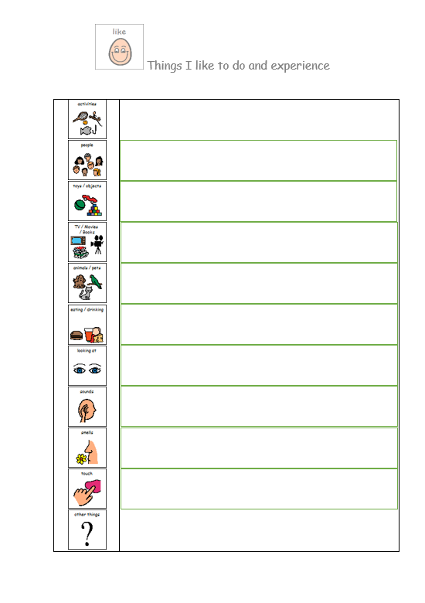
Resource 3

Slide 62
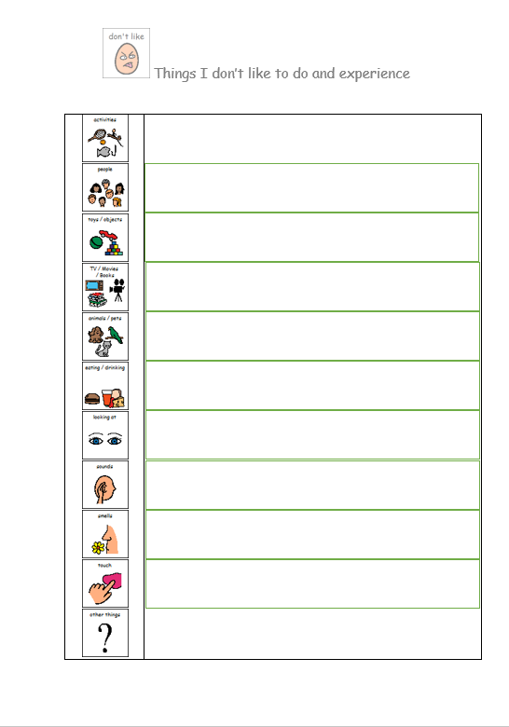
Resource 6

Slide 63
5 Point Scale - Lesson 2
Recap on previous lesson.
Introduce Voice Scale (Resource 13)
Talk about ‘How I feel Scale’ (Resource 14) – discuss when your emotions get more intense that your behaviour starts to change as a result.
Ideas
Share worksheets with a partner.
Practice using different voice examples from the voice scale to show escalation from 1 to 5.
Children can use previous worksheets to help give them ideas on what to put in each section of ‘How I feel Scale’. Children can write or draw their answers depending on year group.

Slide 64
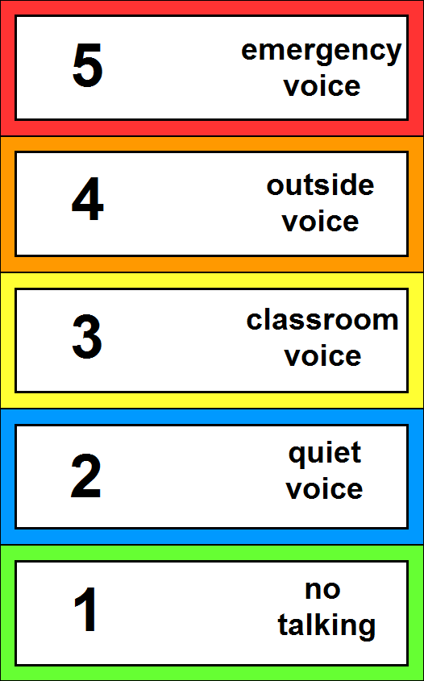
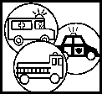
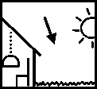

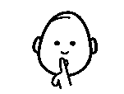

Resource 13

Slide 65
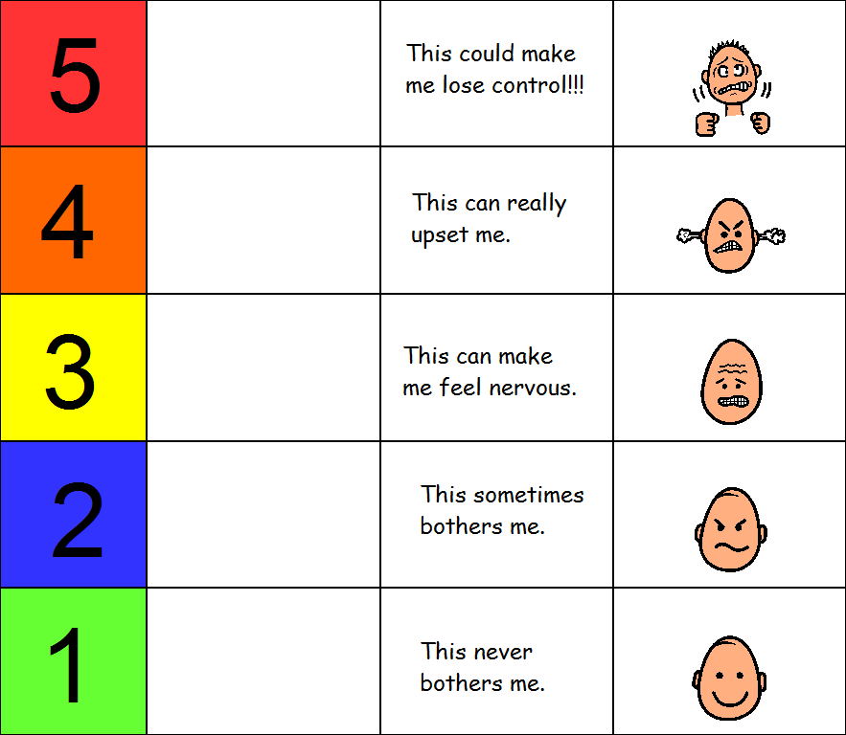
Resource 14

Slide 66
5 Point Scale - Lesson 3
Work through Resource 15 slides with class. This can be done in small groups and collate answers or done as a whole class activity.
Remind children that the left side of the scale is identifying behaviour not feelings and thoughts. The right side is what they would like the teacher to do to help.
Ideas
Use some of the Emotion Talk symbols (from booklet) to help with adding images to the scale.
Make sure most children are in agreement of what the adults support should be.
Discuss what a time out or break from the class would look like. Could an area outside the class be developed for children to go to calm down or have a break from their learning when needed?

Slide 67
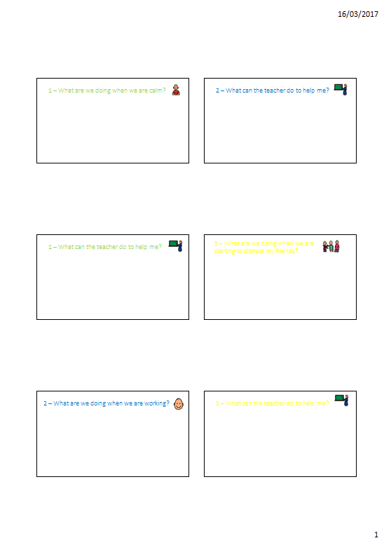
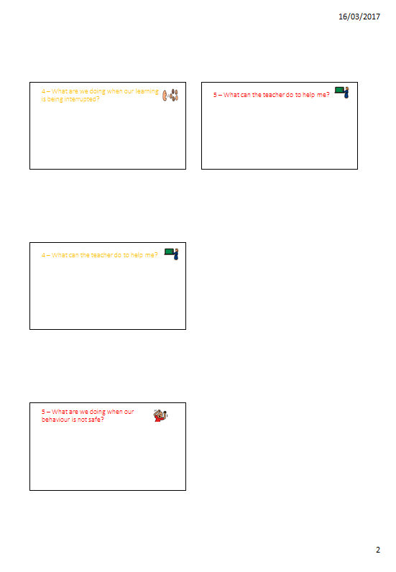
Resource 15

Slide 68
5 Point Scale - Lesson 4
Recap what happened last lesson.
Look at examples of ‘how I feel’ worksheets
Complete ‘Class 5 point scale slides’ (Resources 16)
Ideas
Using the slides completed last lesson. Begin to minimise the language and agree on 1 sentence or a few words for each section.
Discuss what images would be helpful in each section for the children to remember.
Role play scenarios and children can decide what action the teacher needs to take.

Slide 69
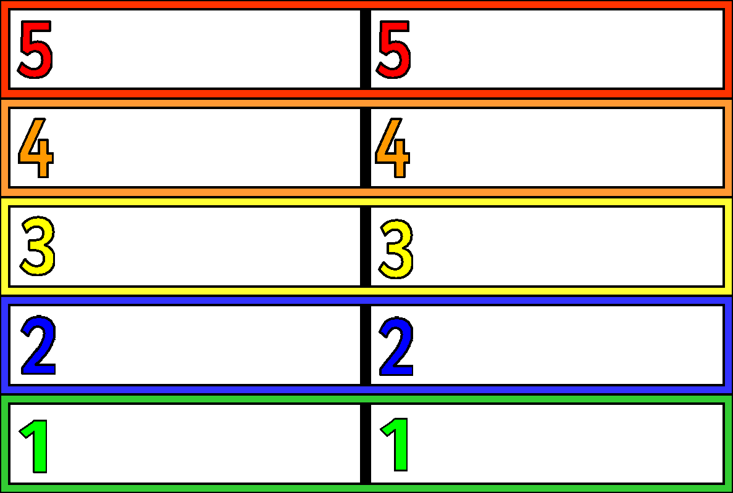
Resource 16

Slide 70
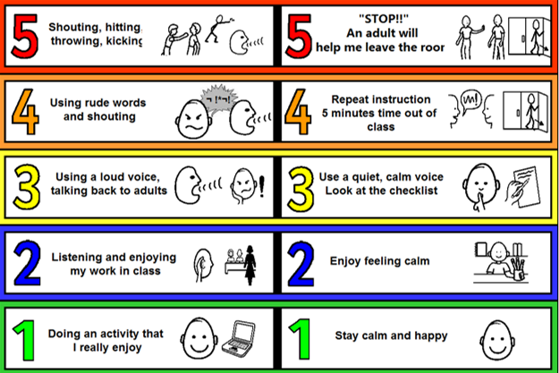
Resource 17

Slide 71
